Slide 1
http://www.vidyanidhi.com/
ketkiacharya.net@gmail.com
Ketki Acharya
From: SM VITA ATC of CDAC
9769201036
ketkiacharya.net@gmail.com

Slide 2
<React.StrictMode>
StrictMode is a tool for highlighting potential problems in an application. Like Fragment , StrictMode does not render any visible UI. It activates additional checks and warnings for its descendants. Note: Strict mode checks are run in development mode only; they do not impact the production build.

Slide 3
JSX is stricter than HTML. You have to close tags like <br />. Your component also can’t return multiple JSX tags. You have to wrap them into a shared parent, like a <div>...</div> or an empty <>...</> wrapper:
function AboutPage() {
return (
<>
<h1>About</h1>
<p>Hello there.<br />How do you do?</p>
</>
);
}
If you have a lot of HTML to port to JSX, you can use an online converter.

Slide 4
Class components uses render function. The ReactDOM.render() function takes two arguments, HTML code and an HTML element.
Purpose of render():
React renders HTML to the web page by using a function called render().
The purpose of the function is to display the specified HTML code inside the specified HTML element.
In the render() method, we can read props and state and return our JSX code to the root component of our app.

Slide 5
Now lets Say along with the Employee Details, we would like to Display Employee Department information as well. One way is to write the Code to display department information in the Employee Component. It is not a good Practice to keep everything in one component. To promote Code reusability, we will split them into different components. So lets create a New Department Component which will display Department Information and this Component can be used by any other component.
{dept,head}
import React from 'react’;
function App() {
return (
<div>
<Header/>
<Employee name="Vidyanidhi" salary="50000" dept="Placement" head="Pooja" />
</div>
);
}
function Header (){
return (
<div>
<h1>Header</h1>
</div>
);
}
function Employee(data) {
return (
<div><p>Name : {data.name}</p>
<p>Salary : {data.salary}</p>
<Department dept={data.dept} head={data.head}/>
</div>
);
}
const Department=(deptInfo)=>{
return <div><p>Dept Name is : <b>{deptInfo.dept}</b></p>
<p>Dept Head is : <b>{deptInfo.head}</b></p>
</div>;
}
export default App;
Employee({name:"Vidyanidhi" salary:"50000" dept="Placement" head="Pooja})
consider this as function call. Function complete its task it will go back to calling function and replace call with value
data
{name:"Vidyanidhi" salary:"50000" dept="Placement" head="Pooja}
Department({dept={data.dept} head={data.head}})
consider this as function call. Function complete its task it will go back to calling function and replace call with value
deptInfo
{dept={data.dept} head={data.head}

Slide 6
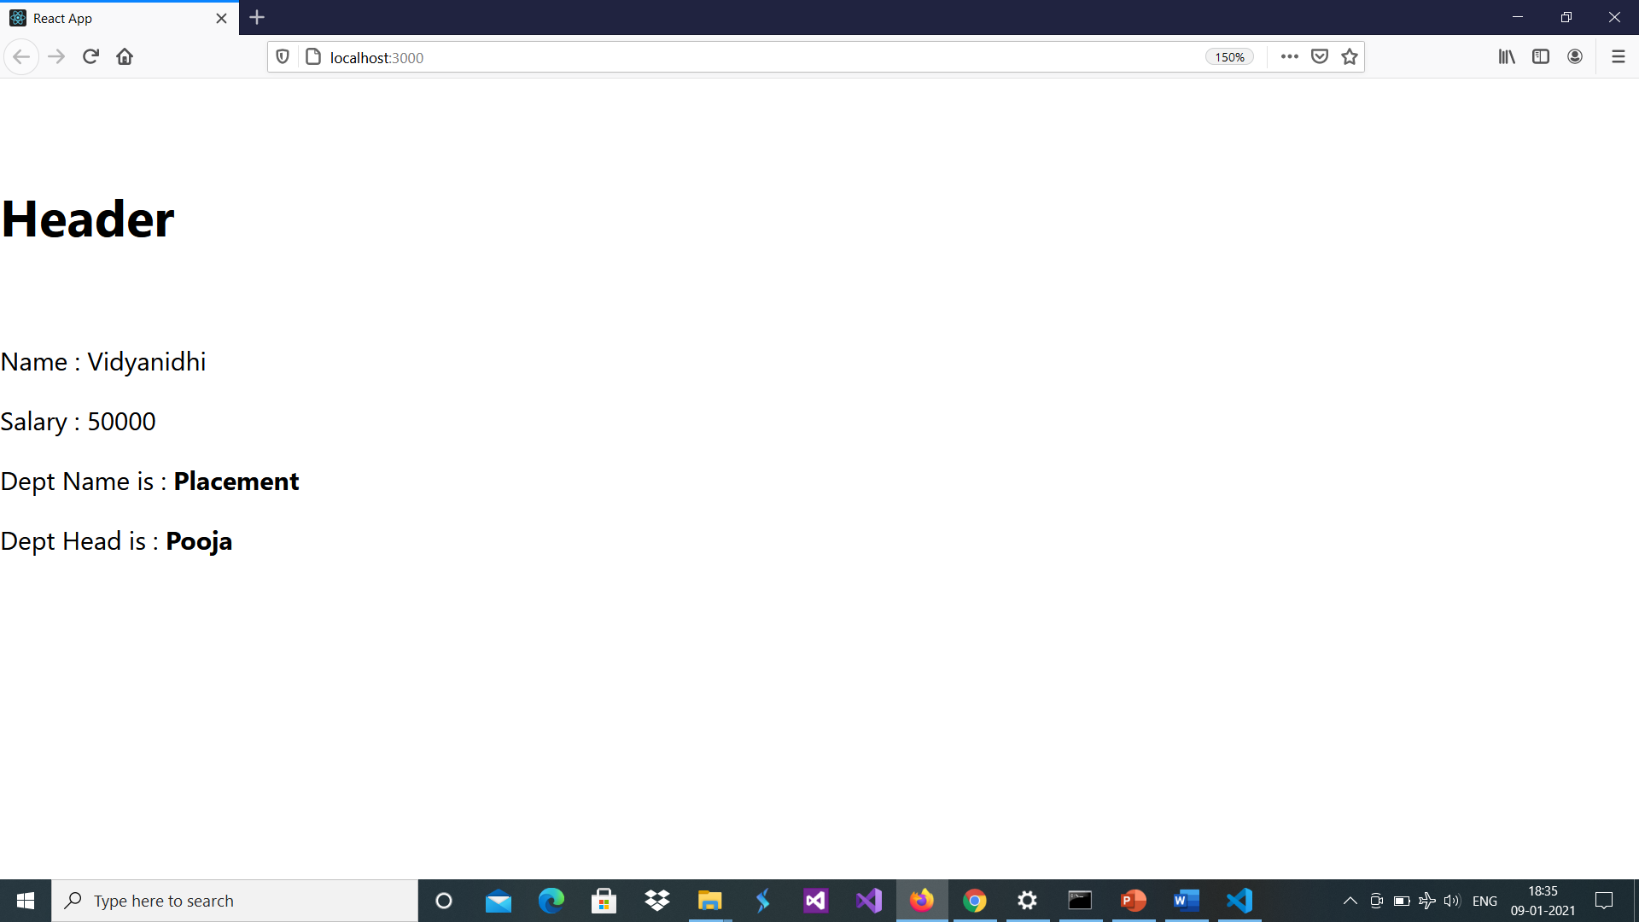
Out put of previous code

Slide 7
One more example
Creating and nesting components
React apps are made out of components. A component is a piece of the UI (user interface) that has its own logic and appearance. A component can be as small as a button, or as large as an entire page.
React components are JavaScript functions that return markup:
function App() {
return (
<div>
<MyApp/>
</div>
);
}
function MyButton() {
return (
<button>
This is a button
</button>
);
}
function MyApp() {
return (
<div>
<h1>Welcome to my app</h1>
<MyButton />
</div>
);
}
export default MyApp;

Slide 8
One more example
Creating and nesting components
React apps are made out of components. A component is a piece of the UI (user interface) that has its own logic and appearance. A component can be as small as a button, or as large as an entire page.
React components are JavaScript functions that return markup:
function App() {
return (
<div>
<MyApp/>
</div>
);
}
function MyButton(data) {
return (
<button>
{data.name}
</button>
);
}
function MyApp() {
return (
<div>
<h1>Welcome to my app</h1>
<MyButton name=“vita” />
<MyButton name=“DAC” />
</div>
);
}
export default App;

Slide 9
Adding styles
In React, you specify a CSS class with className. It works the same way as the HTML class attribute:
import './index.css';
const user = {
name: 'Hedy Lamarr',
imageUrl: 'https://i.imgur.com/yXOvdOSs.jpg',
imageSize: 90,
}; let App = function () {
return (
<>
<h1>{user.name}</h1>
<img
className="avatar"
src={user.imageUrl}
alt={'Photo of ' + user.name}
style={{
width: user.imageSize,
height: user.imageSize }}
/>
</>
);}
export default App;
Index.css
.avatar {
border-radius: 50%;
}
in the above example, style={{}} is not a special syntax, but a regular {} object inside the style={ } JSX curly braces

Slide 10
Difference between export and export default
here are two different types of export,
named and default.
You can have multiple named exports per module but
only one default export[...]
Named exports are useful to export several values.
During the import, it is mandatory to use the same name of the corresponding object.
But a default export can be imported with any name
// in file my-module.js
let myVar;
export default myVar = 123;
import myExportedVar from './my-module'
console.log(myExportedVar); // will log 123
// we have the freedom to use
//'import myExportedVar' instead of 'import myVar'
// because myVar was defined as default export

Slide 11
Importing and Exporting Components
The magic of components lies in their reusability: you can create components that are composed of other components. But as you nest more and more components, it often makes sense to start splitting them into different files. This lets you keep your files easy to scan and reuse components in more places.
Syntax | Export statement | Import statement
Default | export default function Button() {} | import Button from './Button.js';
Named | export function Button() {} | import { Button } from './Button.js';

Slide 12
// Move this to Profile.js!
export function Profile() {
return (
<>
<h1> profile function</h1>
<img
src="https://i.imgur.com/QIrZWGIs.jpg"
alt="Alan L. Hart"
/>
</>
);
}
export default function Gallery() {
return (
<section>
<h1>Amazing scientists Gallery function</h1>
<Profile />
<Profile />
<Profile />
</section>
);
}
import Gallery from './Gallery.js';
import { Profile } from './Gallery.js';
export default function App() {
return (
<>
<Profile />
<Gallery/>
</>
);
}

Slide 13
// Move me to Profile.js!
export function Profile({mysrc, myalt}) {
return (
<>
<h1> profile function</h1>
<img
src={mysrc}
alt = {myalt} />
</>
);
}
export default function Gallery() {
return (
<section>
<h1>Amazing scientists Gallery function</h1>
<Profile mysrc= https://i.imgur.com/QIrZWGIs.jpg’ myalt="Alan L. Hart" />
<Profile mysrc='https://i.imgur.com/yXOvdOSs.jpg’ myalt= 'Hedy Lamarr />
</section>
);
}
import Gallery from './Gallery.js';
import { Profile } from './Gallery.js';
export default function App() {
return (
<>
<Gallery/>
</>
);
}

Slide 14
Use of props
Object
{ person={{ name: 'Desert', imageId: 0 }}
size={200}
}
import { Avatar } from "./Avatar";
export default function Profile() {
return (
<div>
<Avatar person={{ name: 'Desert', imageId: 0 }}
size={200}/><br/>
<Avatar person={{ name: 'Koala', imageId: 1 }}
size={100}/><br/>
<Avatar person={{ name: 'Panguin', imageId: 2 }}/><br/>
</div>
);
}
import Profile from './Profile'
import './App.css';
function App() {
return (
<div>
<Profile/>
</div>
);
}
export default App;
Hear Avatar is reusable component
Object DE structuring
import { Getimg } from "./util";
export function Avatar({person,size=200}) {
//read image name from array and concat
const imgurl=Getimg(person.imageId);
const imgsrc='Images/'+imgurl+'.jpg’;
console.log(person.imageId+ " "+person.name)
return (
<>
<img
className="avatar"
src={imgsrc}
alt={person.name}
width={size}
height={size}
/> <h3>{person.name}</h3>
</>
);
}
util.js //save in small case
export function Getimg(i)
{
const imgurl=['Desert','Koala','Penguins'];
return imgurl[i];
}
Array has name of images
Store above image in public folder

